Slide 1
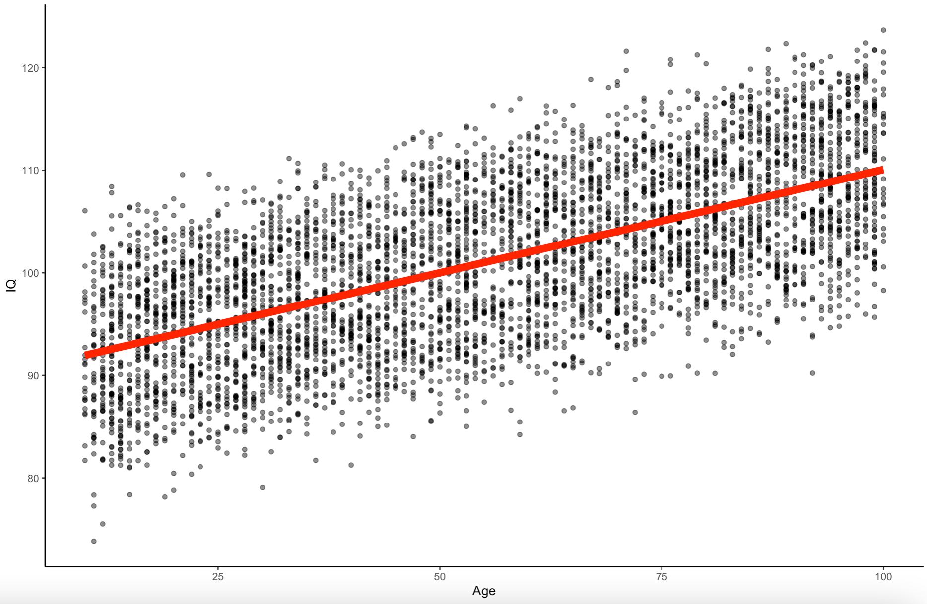
Multiple Regression, Moderation, and Mediation Chad C. Williams www.chadcwilliams.com

Slide 2
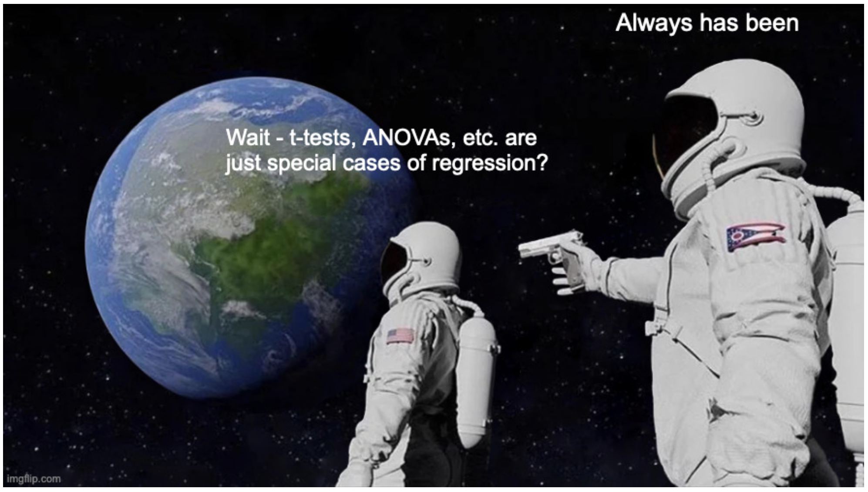

Slide 3
www.github.com/chadcwilliams > Repositories > R Workshops

Slide 4
Outline
Multiple Regression Conceptual
Multiple Regression Applied
Moderation Conceptual
Mediation Conceptual
Moderation Applied
Mediation Applied

Slide 5
Outline
Multiple Regression Conceptual
Multiple Regression Applied
Moderation Conceptual
Mediation Conceptual
Moderation Applied
Mediation Applied

Slide 6
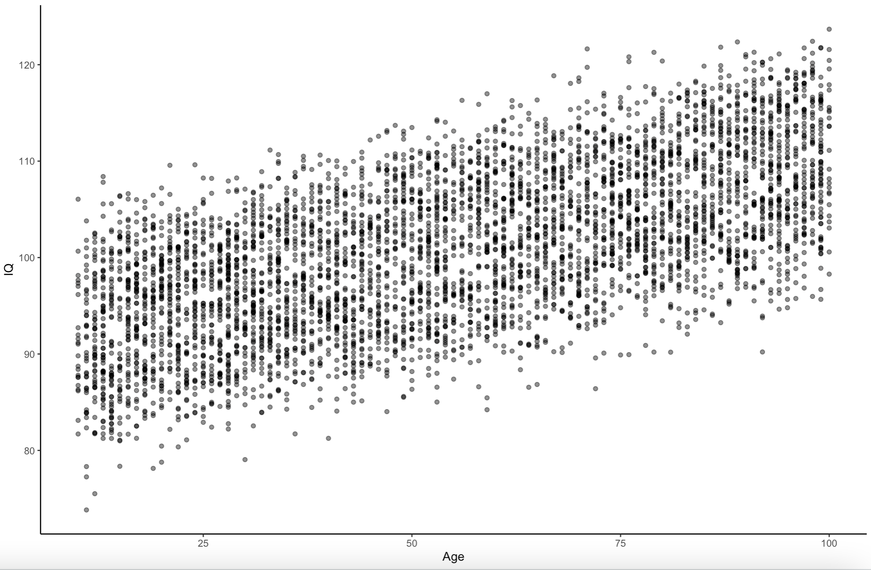
The Data
Made up
N = 5000
Age, IQ, Education

Slide 7
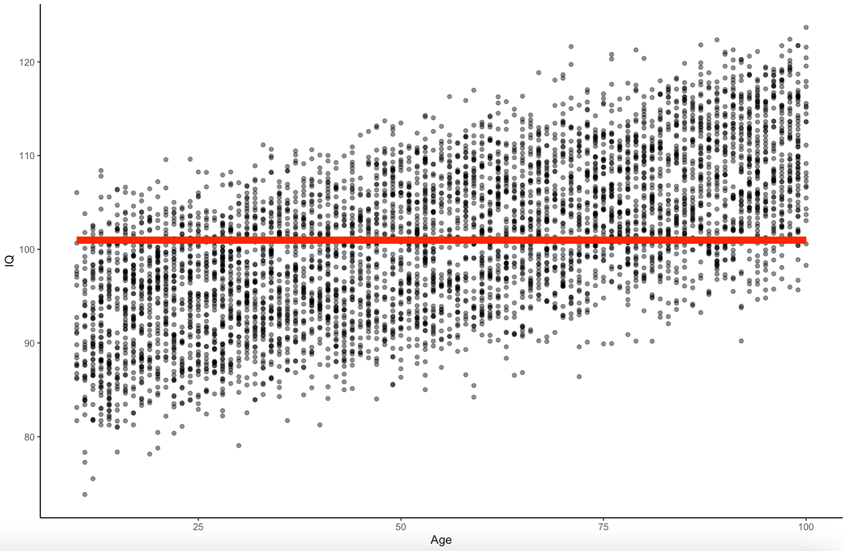
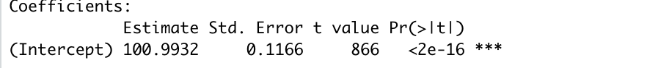
What is this?
The mean
Equation:
Y ~ β₀ + ε
IQ ~ Mean + ε

Slide 8
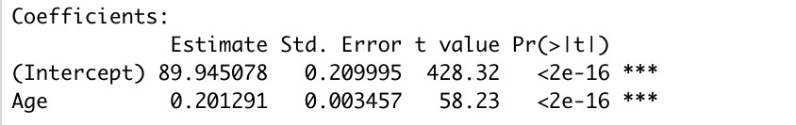
What is this?
Simple Regression
Equation:
Y ~ β₀ + β₁X + ε
IQ ~ β₀ + β₁Age + ε

Slide 9
Equations
DV
Slope
Error
Y ~ β₀ + β₁X₁ + ε
Y-Int
IV

Slide 10
Equations
Coefficient
Outcome
Residual
Y ~ β₀ + β₁X₁ + ε
Predictor
Coefficient

Slide 11
Equations
DV
Slope
Error
Y ~ β₀ + β₁X₁ + ε
Y-Int
IV
IQ ~ β₀ + β₁Age + ε

Slide 12
What is this?
Correlation/Regression
Equation:
Y ~ β₀ + β₁X + ε
IQ ~ β₀ + β₁Age + ε

Slide 13
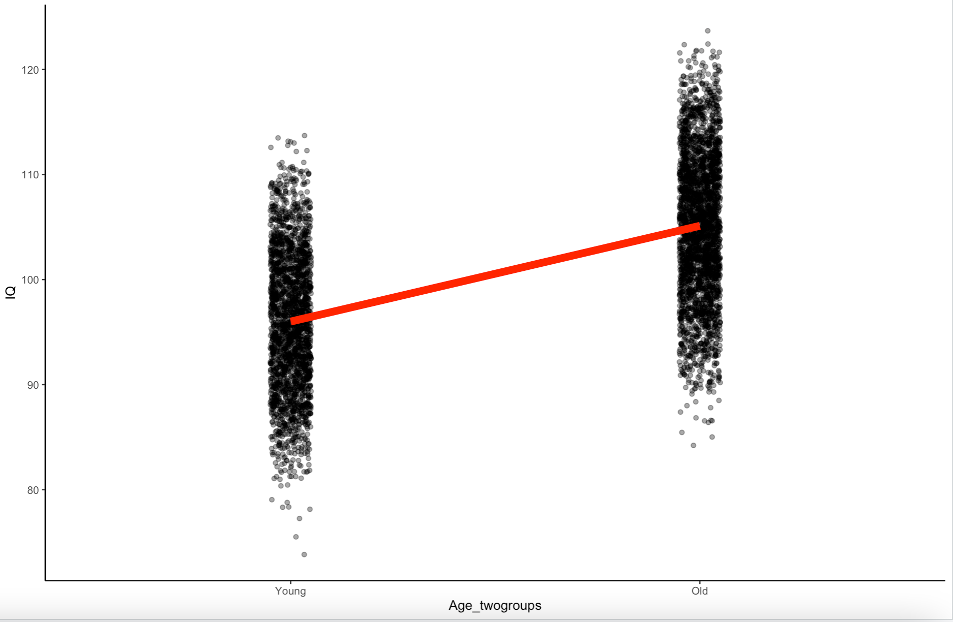
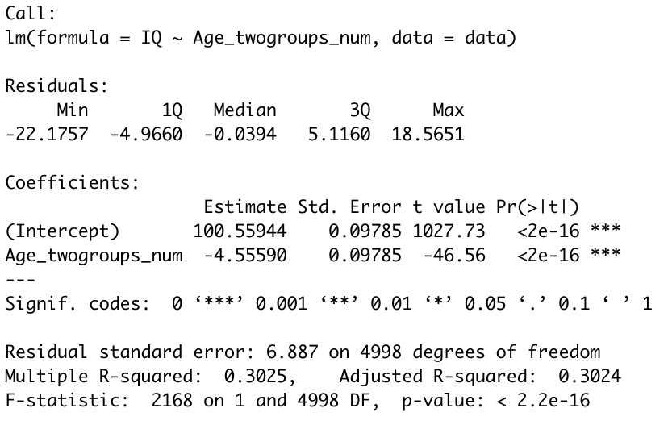
What is this?
T-Test
Equation:
Y ~ β₀ + β₁X + ε
IQ ~ β₀ + β₁Age + ε

Slide 14
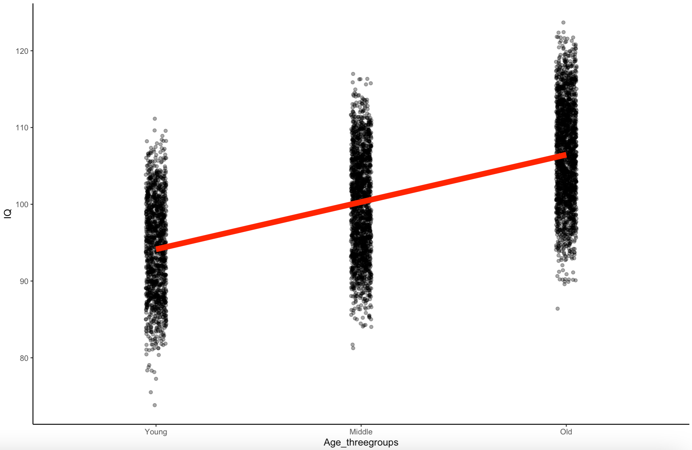
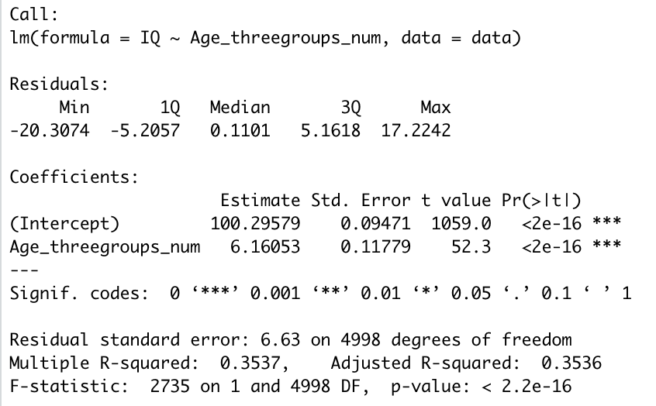
What is this?
One-Way ANOVA
Equation:
Y ~ β₀ + β₁X + ε
IQ ~ β₀ + β₁Age + ε

Slide 15
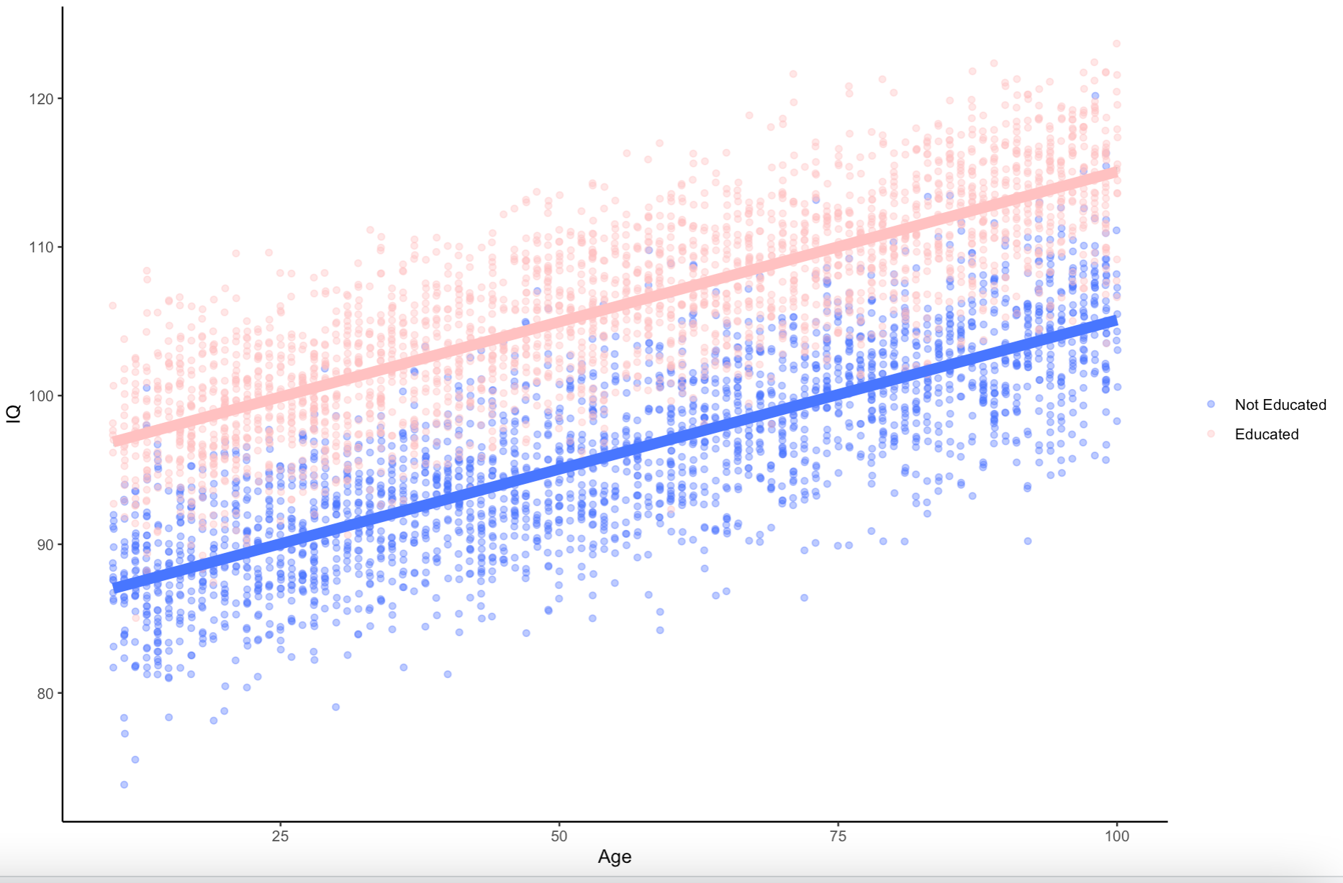
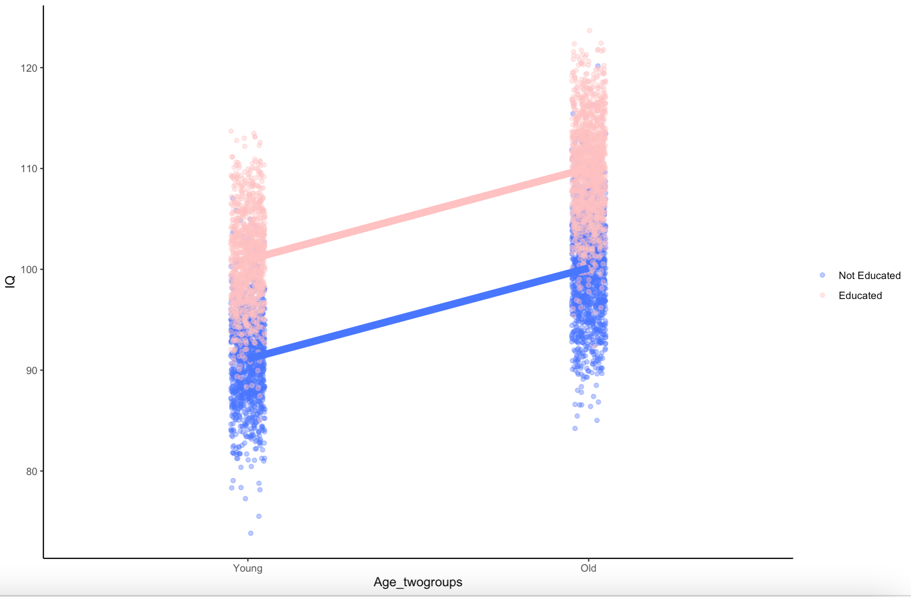
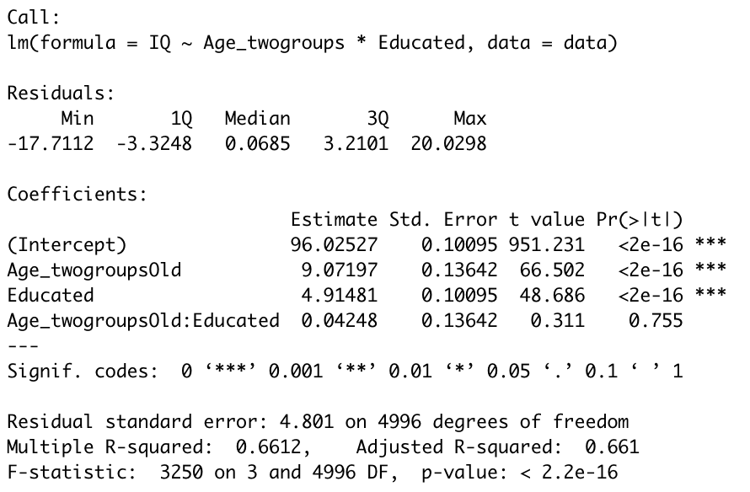
What is this?
Two-Way ANOVA
Equation:
Y ~ β₀ + β₁X₁ + β₂X₂ + ε
IQ ~ β₀ + β₁Age + β₂Education + ε

Slide 16
Equations
DV
Slope
Error
Y ~ β₀ + β₁X₁ + ε
Y-Int
IV

Slide 17
Equations
DV
Slope1
Slope2
Slope3
Error
Y ~ β₀ + β₁X₁ + β₂X₂ + β₃X₃ + ε
Y-Int
IV1
IV2
IV3

Slide 18
Equations
Y ~ β₀ + β₁X₁ + β₂X₂ + β₃X₃ + ε
IQ ~ β₀ + β₁Age + β₂Edu + β₃SES + ε

Slide 19
What is this?
Two-Way ANOVA
Equation:
Y ~ β₀ + β₁X₁ + β₂X₂ + ε
IQ ~ β₀ + β₁Age + β₂Education + ε

Slide 20
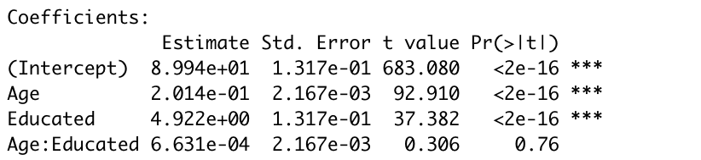
What is this?
Multiple Regression
Equation:
Y ~ β₀ + β₁X₁ + β₂X₂ + ε
IQ ~ β₀ + β₁Age + β₂Education + ε

Slide 21
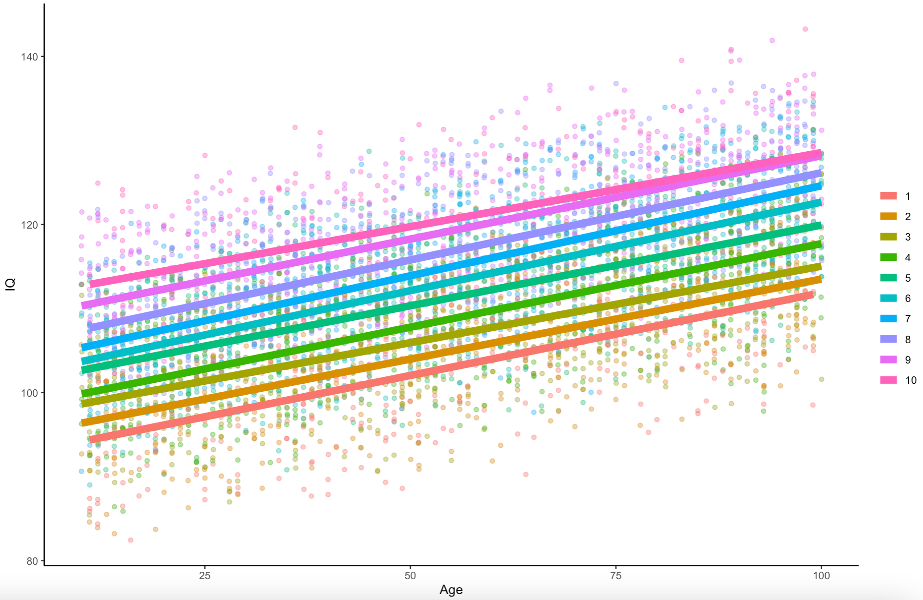
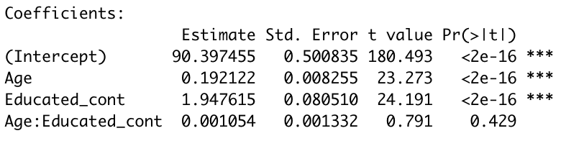
What is this?
Multiple Regression
Equation:
Y ~ β₀ + β₁X₁ + β₂X₂ + ε
IQ ~ β₀ + β₁Age + β₂Education + ε

Slide 22
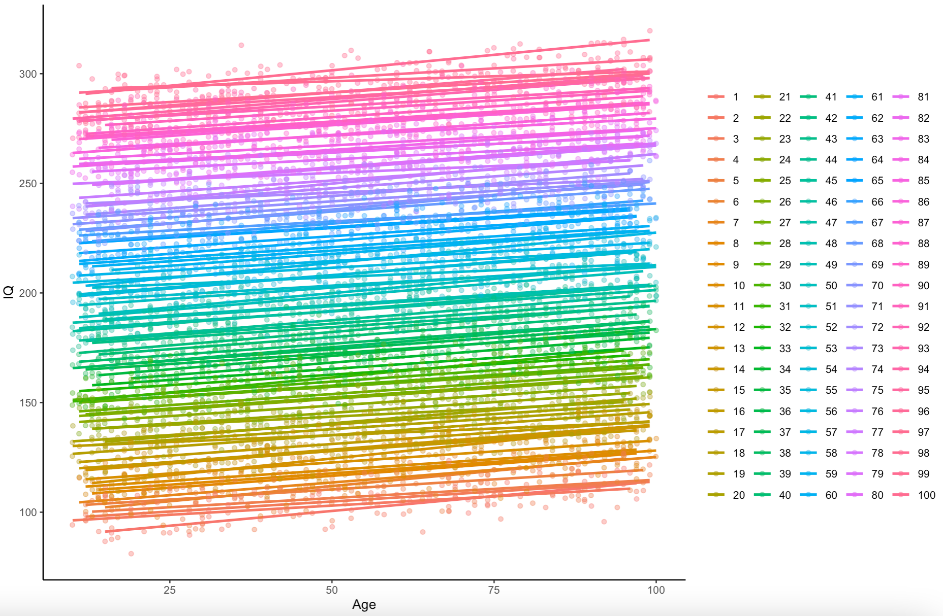
What is this?
Multiple Regression
Equation:
Y ~ β₀ + β₁X₁ + β₂X₂ + ε
IQ ~ β₀ + β₁Age + β₂Education + ε

Slide 23
Coding Variables & Reading Coefficients

Slide 24
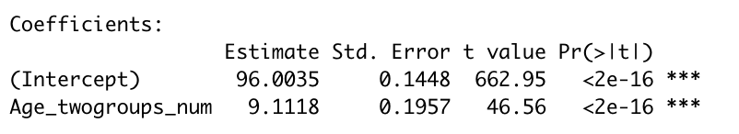
0
1
Dummy Coding:
What is this?
T-Test
Equation:
Y ~ β₀ + β₁X + ε

Slide 25
-1
0
+1
Contrast Coding:
What is this?
T-Test
Equation:
Y ~ β₀ + β₁X + ε

Slide 26
-1
0
+1
Contrast Coding:
What is this?
One-Way ANOVA
Equation:
Y ~ β₀ + β₁X + ε

Slide 27
-1
-1
+2
Contrast Coding:
What is this?
One-Way ANOVA
Equation:
Y ~ β₀ + β₁X + ε

Slide 28
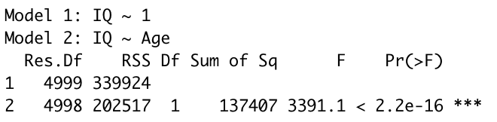
Hierarchical Regression
IQ ~ β₀ + ε
IQ ~ β₀ + β₁Age + ε

Slide 29
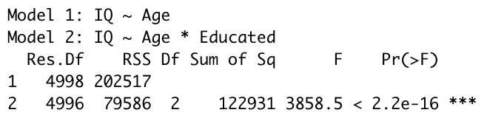
Hierarchical Regression
IQ ~ β₀ + β₁Age + ε
IQ ~ β₀ + β₁Age + β₂Education + ε

Slide 30
Outline
Multiple Regression Conceptual
Multiple Regression Applied
Moderation Conceptual
Mediation Conceptual
Moderation Applied
Mediation Applied

Slide 31

Multiple Regression in R

Slide 32
Outline
Multiple Regression Conceptual
Multiple Regression Applied
Moderation Conceptual
Mediation Conceptual
Moderation Applied
Mediation Applied

Slide 33

DISCLAIMER

Slide 34
Moderation
M
IV
DV

Slide 35
Moderation
Self-Efficacy
Task Importance
Task Anxiety

Slide 36
Moderation
M
IV
DV

Slide 37
Outline
Multiple Regression Conceptual
Multiple Regression Applied
Moderation Conceptual
Mediation Conceptual
Moderation Applied
Mediation Applied

Slide 38
Mediation
IV
M
DV

Slide 39
Mediation
M
IV
DV

Slide 40
Mediation
Access to Healthcare
Income
Years lived

Slide 41
Mediation (Path Analysis – Baron & Kelly, 1986)
IV
DV
C
M
A
B
IV
DV
C’

Slide 42
Mediation (Path Analysis – Baron & Kelly, 1986)
IV
DV
C
M
A
B
IV
DV
C’

Slide 43
Outline
Multiple Regression Conceptual
Multiple Regression Applied
Moderation Conceptual
Mediation Conceptual
Moderation Applied
Mediation Applied

Slide 44
Moderation and Mediation in R

